Slide 1
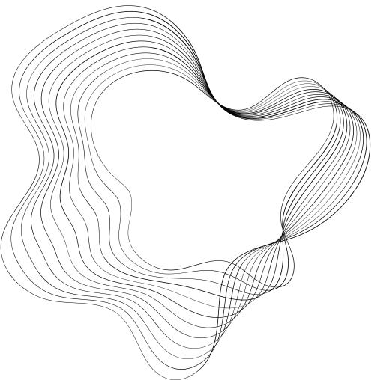


LARANA, INC.
Breast Cancer Classification
"PREDICTIVE MODELING OF BREAST CANCER USING LOGISTIC REGRESSION: A COMPREHENSIVE ANALYSIS"

Slide 2

OUR TEAM
01
02
03
04
DEEPAK SINGH
BISHAL SAHA
JEEVANSHU
JAPJEET SINGH
E22CSEU1516
E22CSEU0755.
E22CSEU0760
E22CSEU0767

Slide 3


INTRODUCTION
The primary aim is to utilize logistic regression as a predictive tool for the classification of breast cancer cases.
Develop a reliable and interpretable model that can assist in early detection and diagnosis.
CUSTOMERS

Slide 4

ABSTRACT
- A study on breast cancer diagnosis using Logistic Regression.
- Evaluation of model performance through Confusion Matrix and ROC Curve.
- Precision-Recall analysis for detailed evaluation.
- Cross-validation for assessing model accuracy.

Slide 5

METHODS OR ALGORITHM USED
01
LOGISTIC REGRESSION
02
CONFUSION MATIX
03
K-FOLD CROSS VALIDATION
04
RECIEVER OPERATIONAL CURVE
05
PRECISION -RECALL CURVE

Slide 6





GOALS AND OBJECTIVES
Objective n° 1
Objective n° 2
Project Objective:
The project aims to develop a reliable logistic regression model for the accurate classification of breast cancer cases, contributing to improved diagnostic capabilities.
Performance Evaluation: Assess the model's performance using various metrics such as accuracy, precision, recall using confusion matrix to ensure its reliability and effectiveness.

Slide 7
RESULTS
1. *MODEL PERFORMANCE*: YOU CAN ASSESS HOW WELL THE LOGISTIC REGRESSION MODEL PERFORMS IN DIAGNOSING BREAST CANCER BASED ON THE DATASET YOU HAVE. THIS INCLUDES METRICS SUCH AS ACCURACY, PRECISION, RECALL USING CONFUSION MATRIX
2. *CONFUSION MATRIX*: BY VISUALIZING THE CONFUSION MATRIX, YOU CAN SEE HOW MANY TRUE POSITIVES, TRUE NEGATIVES, FALSE POSITIVES, AND FALSE NEGATIVES THE MODEL PRODUCED. THIS HELPS IN UNDERSTANDING WHERE THE MODEL MAY BE MAKING ERRORS.
3. *ROC CURVE*: THE ROC CURVE AND AUC (AREA UNDER THE CURVE) PROVIDE A GRAPHICAL REPRESENTATION OF THE MODEL'S ABILITY TO DISTINGUISH BETWEEN POSITIVE AND NEGATIVE CASES. THE AUC VALUE GIVES YOU A SINGLE NUMBER TO SUMMARIZE THIS PERFORMANCE.
4. *PRECISION-RECALL CURVE*: THE PRECISION-RECALL CURVE, ALONG WITH THE AVERAGE PRECISION (AP) SCORE, PROVIDES INSIGHTS INTO HOW WELL THE MODEL PERFORMS, ESPECIALLY IN CASES OF CLASS IMBALANCE. IT HELPS YOU UNDERSTAND TRADE-OFFS BETWEEN PRECISION AND RECALL.
5. *CROSS-VALIDATION RESULTS*: CROSS-VALIDATION RESULTS GIVE YOU AN ESTIMATE OF THE MODEL'S ACCURACY AND ITS VARIABILITY ACROSS DIFFERENT SUBSETS OF THE DATA. THE MEAN ACCURACY AND STANDARD DEVIATION PROVIDE INSIGHTS INTO THE STABILITY OF THE MODEL'S PERFORMANCE.

Slide 8

THANK'S FOR WATCHING

